Slide 1
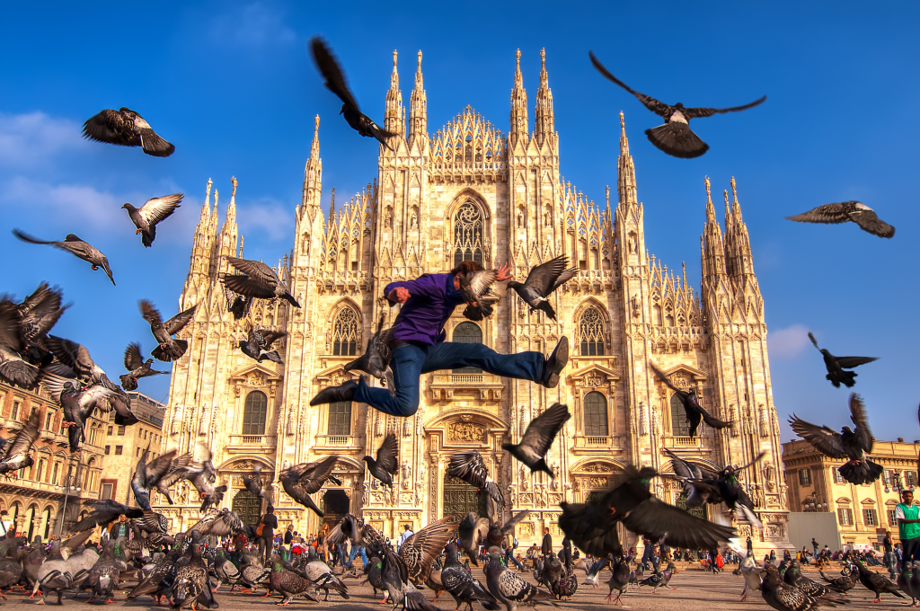








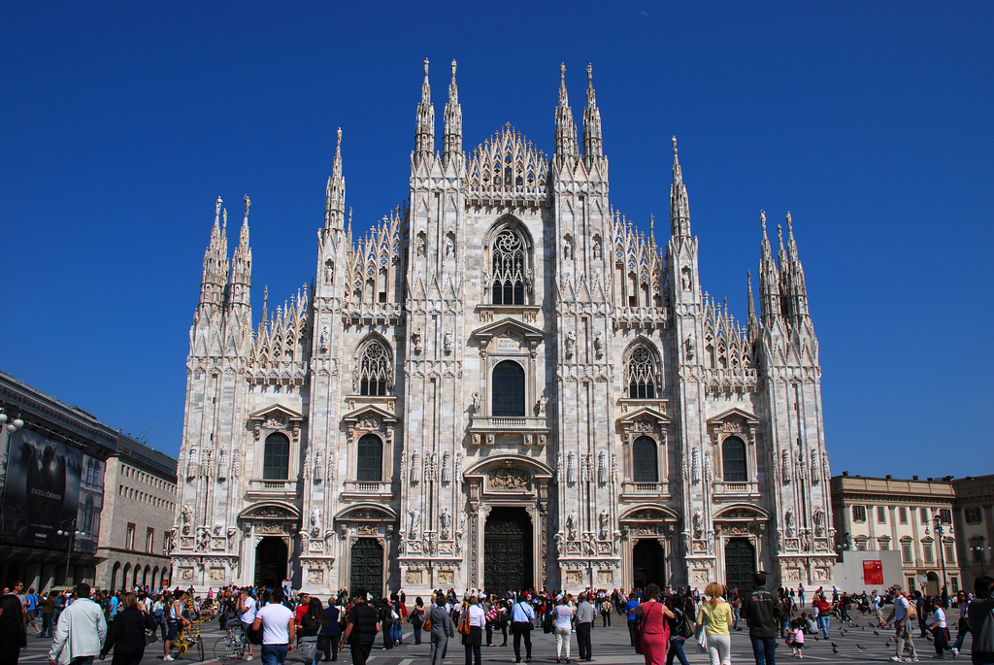
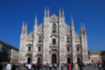
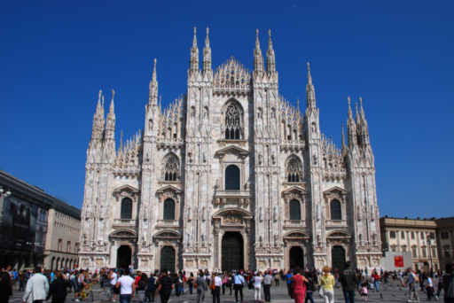

Slide 2
…
…
Downsample & BRIEF
Downsample & BRIEF
Downsample & BRIEF
Downsample & BRIEF
Downsample & BRIEF
Downsample & BRIEF
Downsample & BRIEF
Downsample & BRIEF
BRIEF-Gist Descriptor
BRIEF-Gist Descriptor

Slide 3
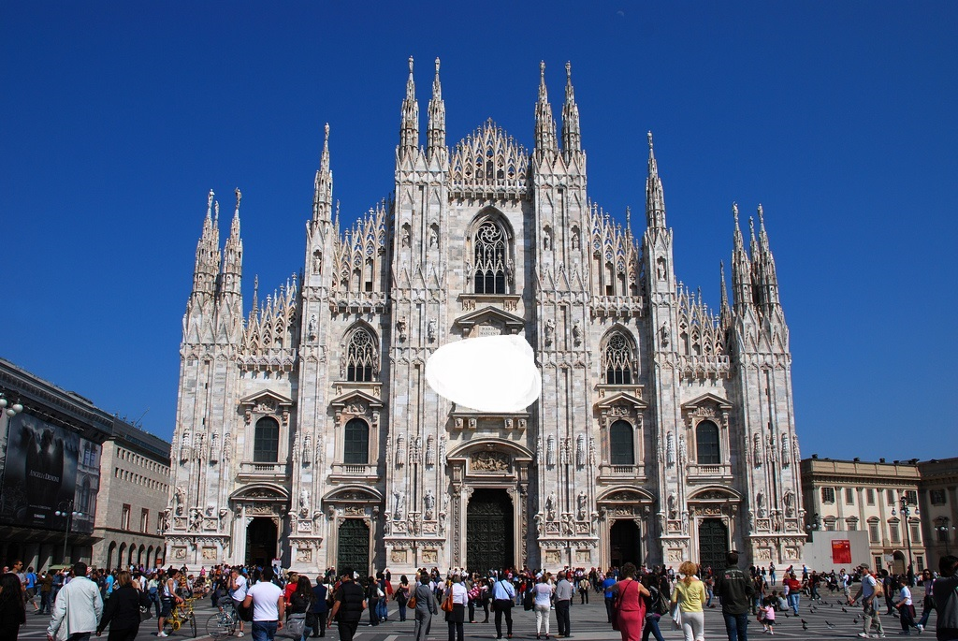
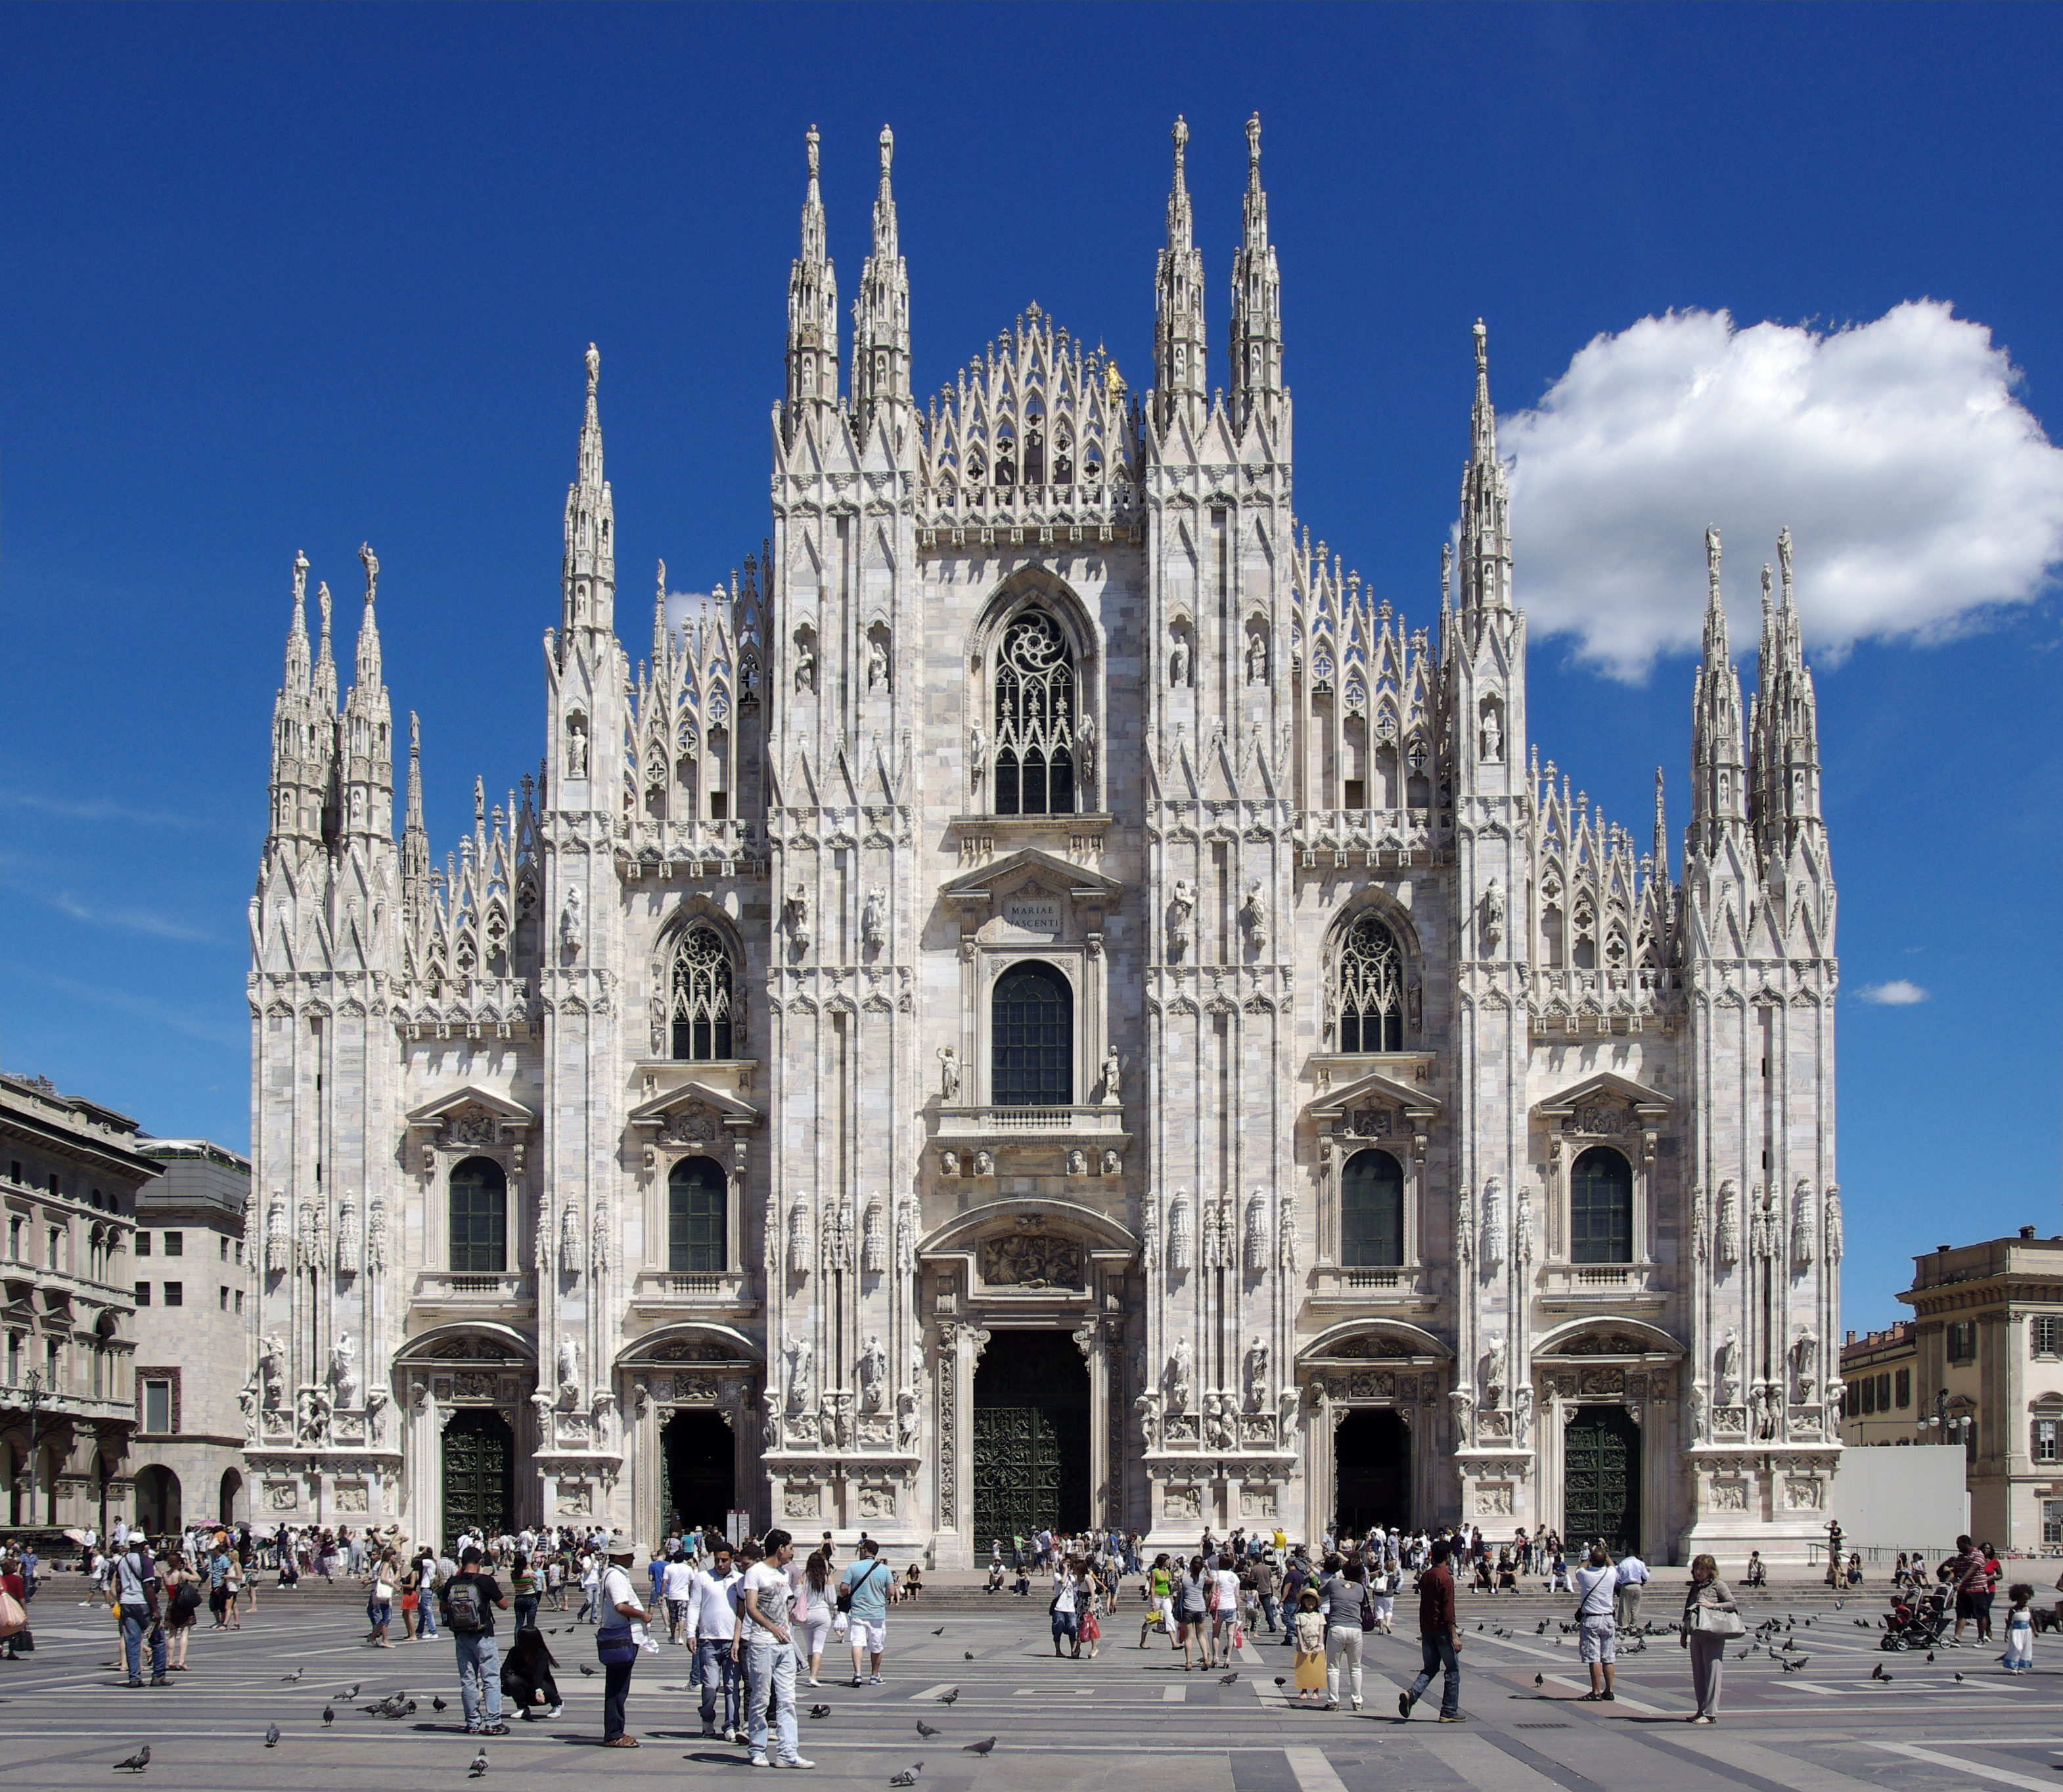
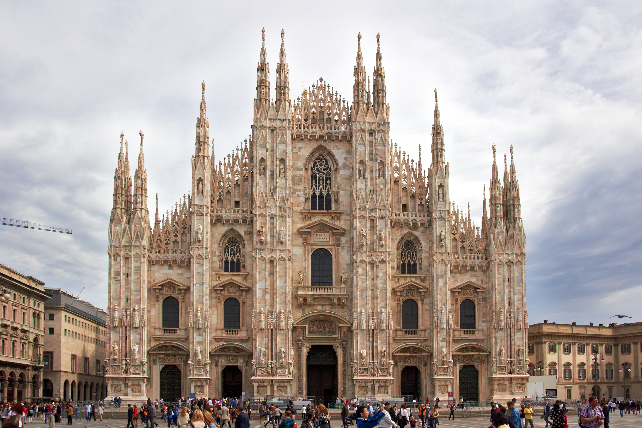
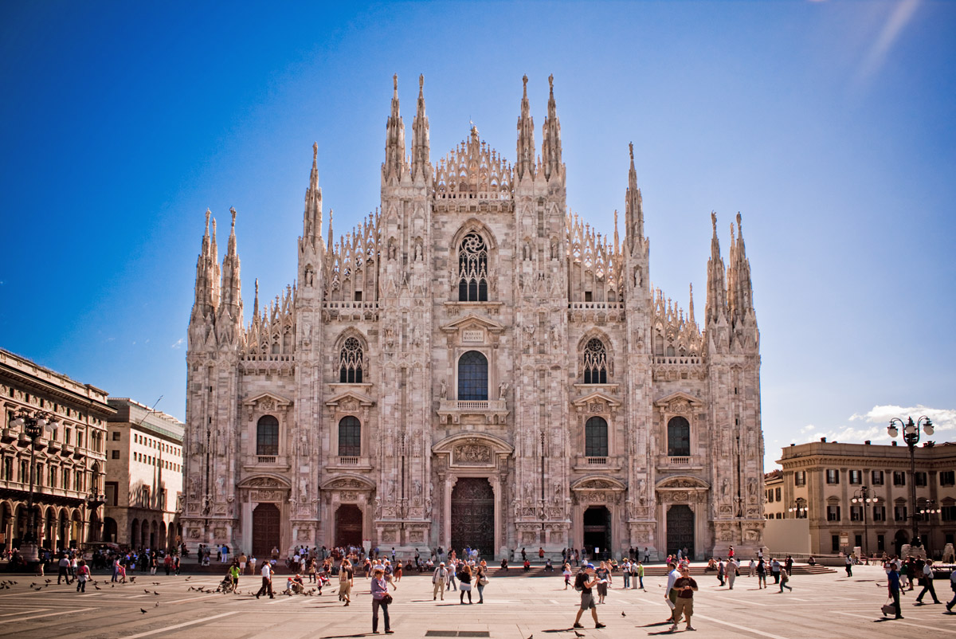
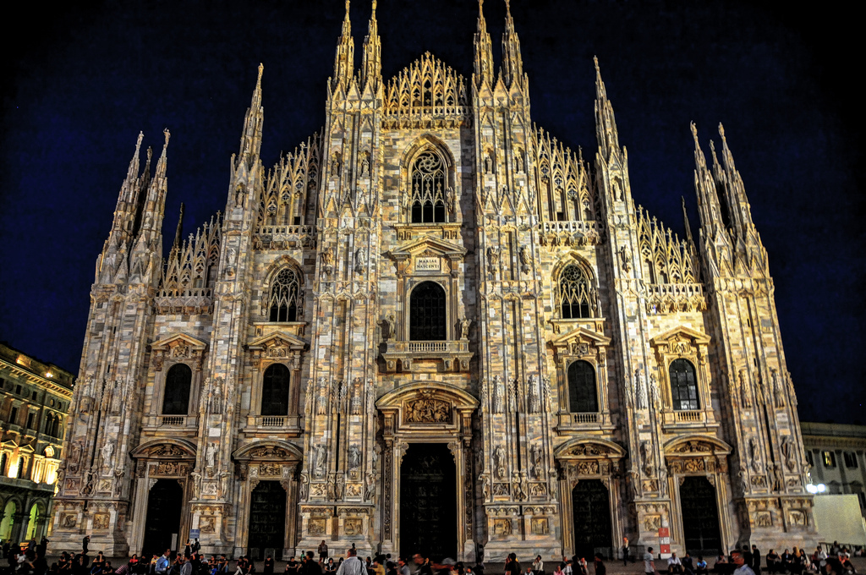
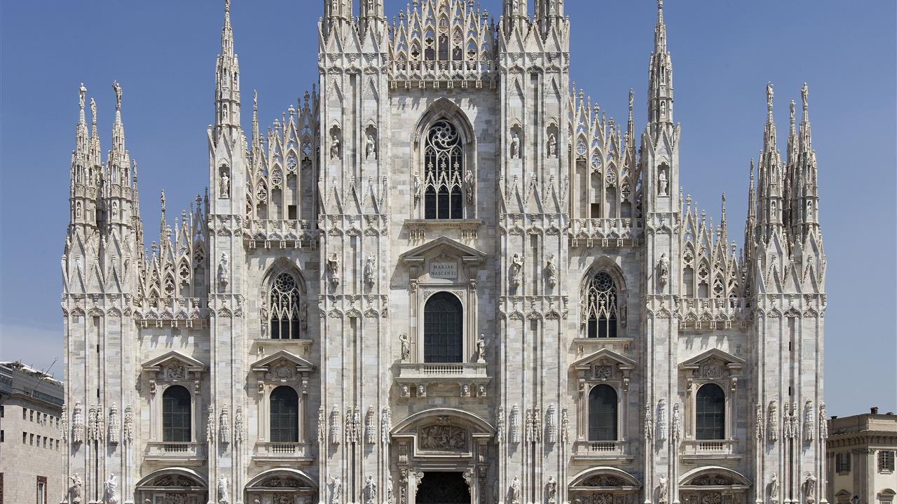
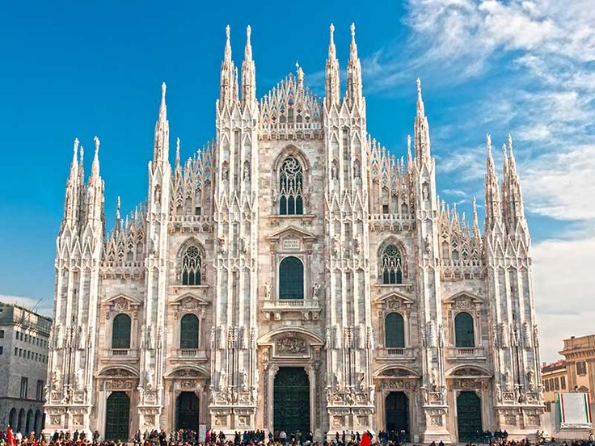
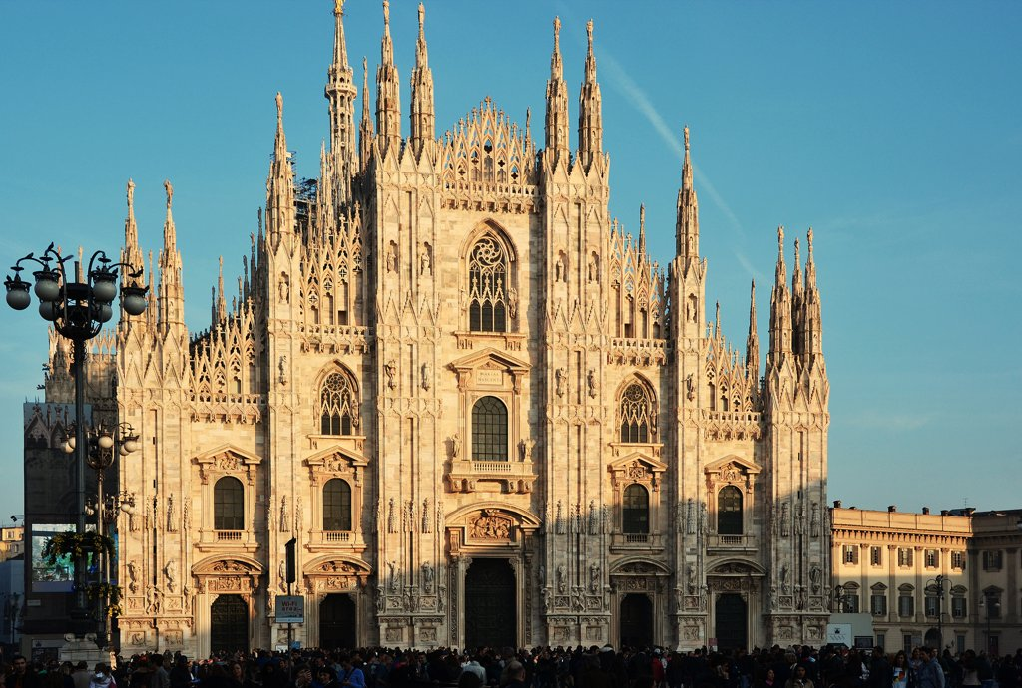
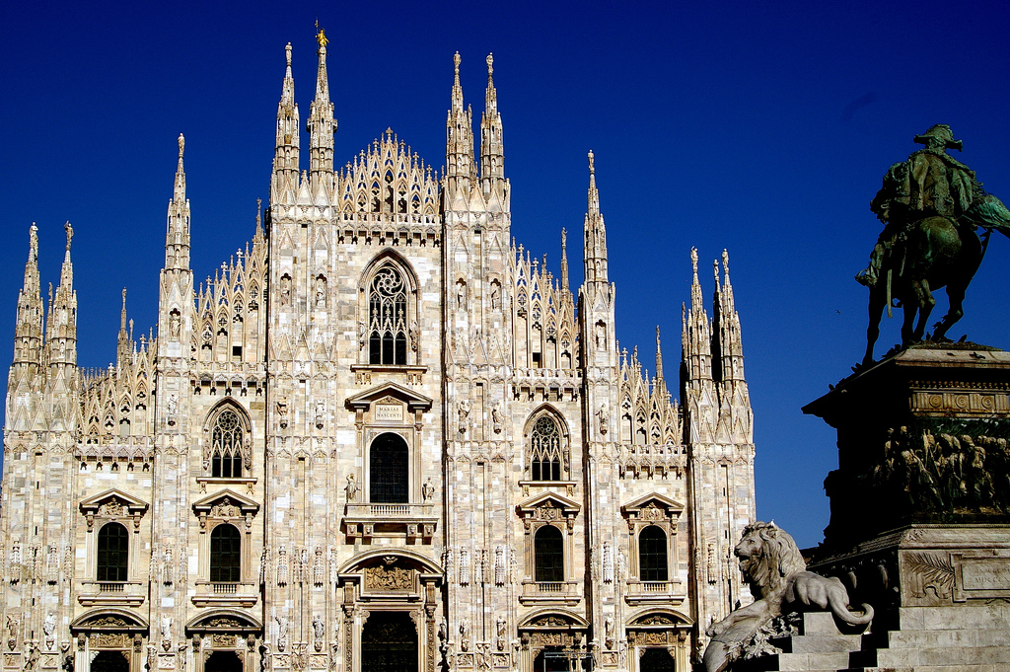
Intermediate Reconstructions
Image Completion using Exemplar #1
Recon1
Exemplar Selection
Reconstruction using Recon1 & Recon2
Image Completion using Exemplar #2
Recon1

Slide 4
colorCorr1
recon1
normalP1
pMat1
Probability-Based Reconstruction
recon
colorCorr2
recon2
normalP2
pMat2

Slide 5
P

